Slide 1
Compiler I: Syntax Analysis
project 2
Yana Gabelev

Slide 2
Links
Project 2:
http://my.jce.ac.il/~arikgi/Web/Ex/Ex02/index.htm
EX02 zip :
http://my.jce.ac.il/~arikgi/Web/Ex/Ex02/Ex02.zip
Text comparer (if TextComparer.bat won’t work):
http://www.diffnow.com/
http://text-compare.com/

Slide 3
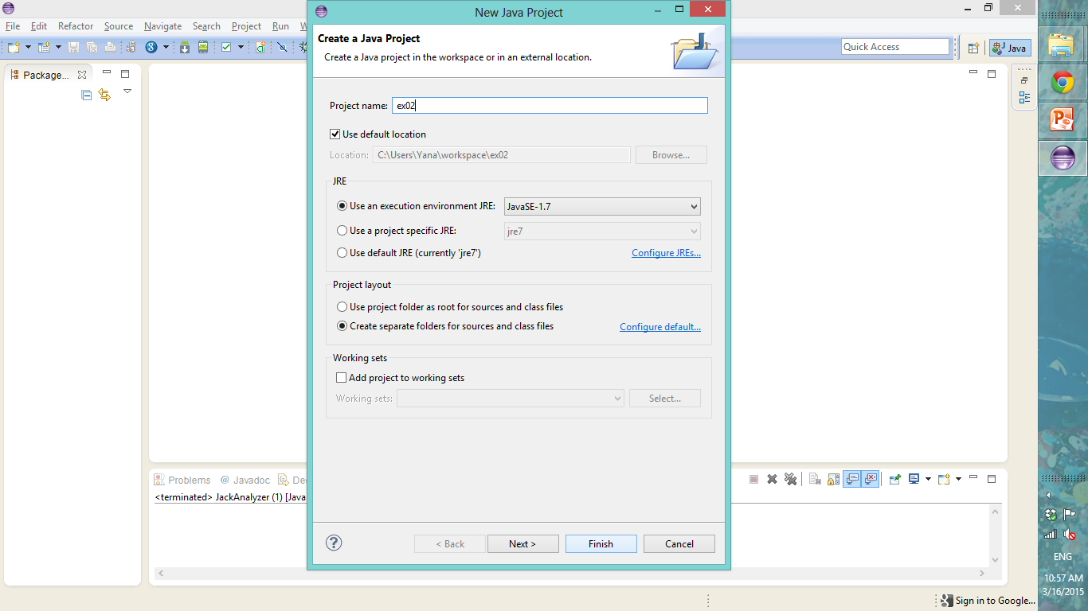
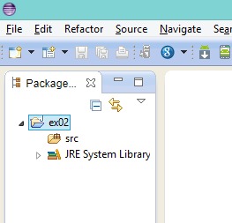
How to start?
First download the Ex02.zip and create a new java project.

Slide 4
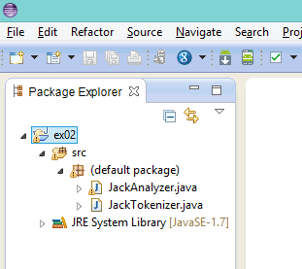
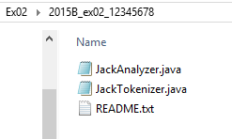
Copy the available source files (JackAnalyzer.java, JackTokenizer.java) from Ex02.zip (2015B_ex02_12345678 folder).

Slide 5
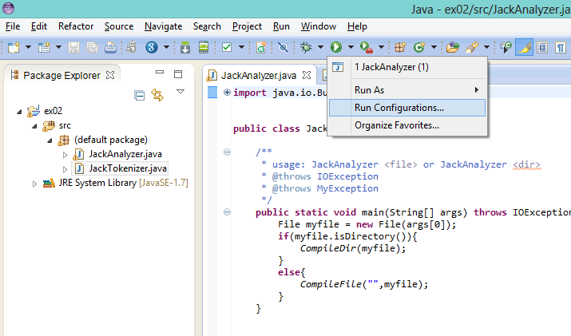
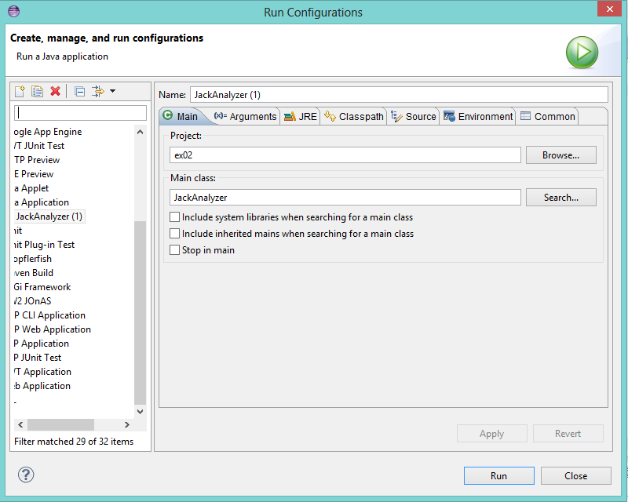
Running JackAnalyzer.java.

Slide 6
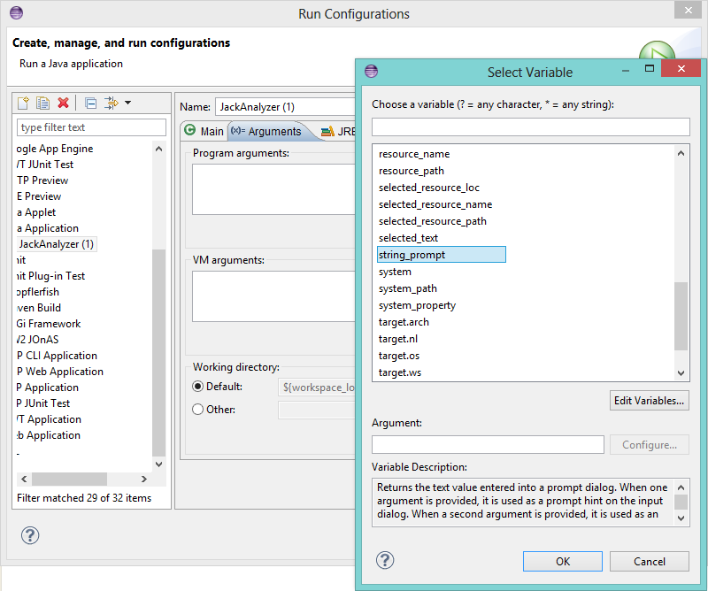
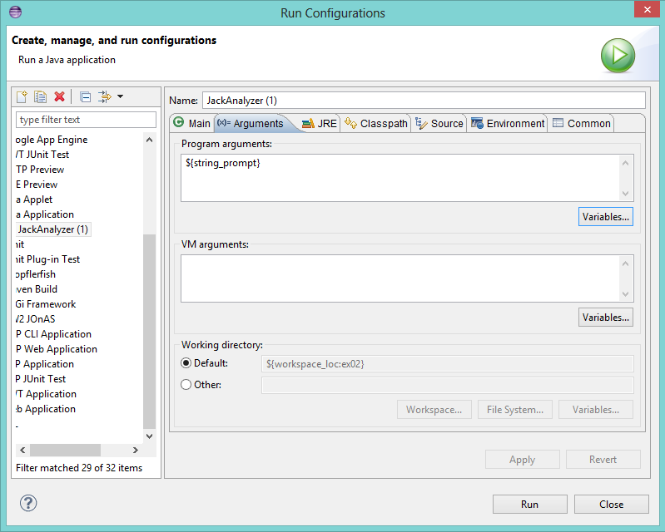
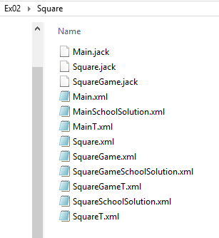
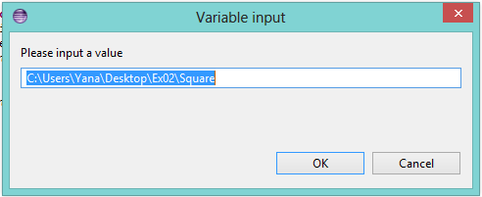

Slide 7
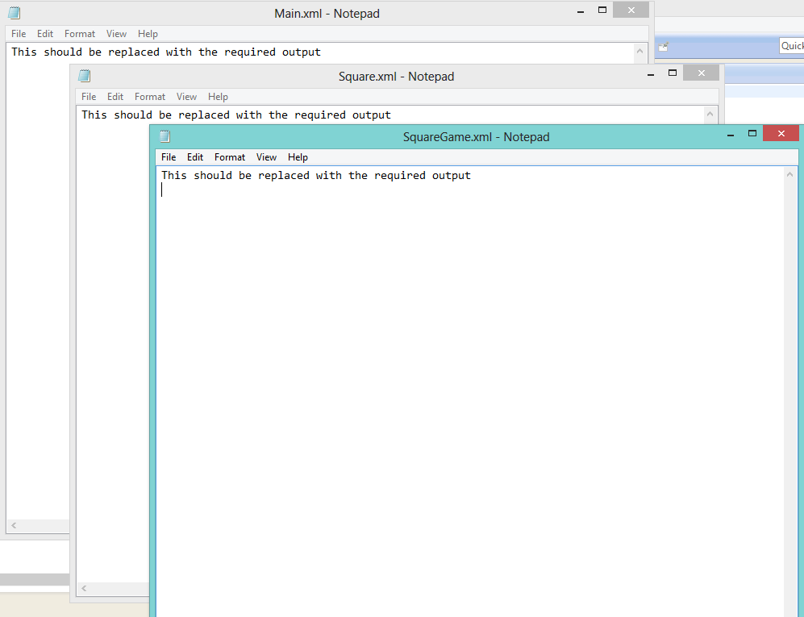
You should get these output.

Slide 8
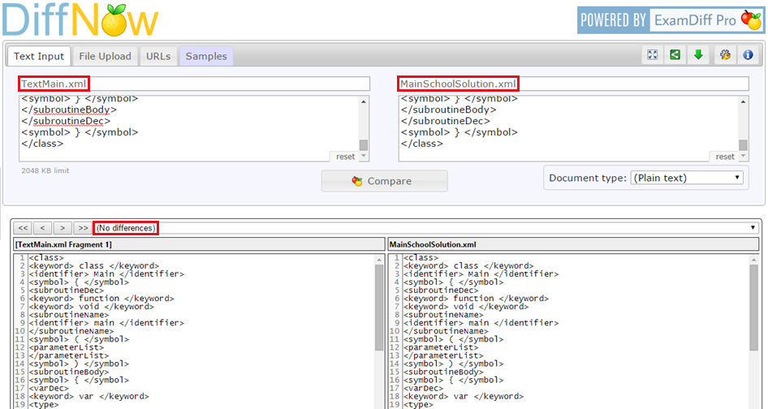
Testing the output (example)

Slide 9
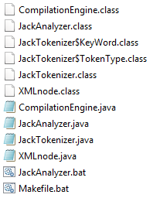
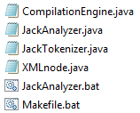
Compiling script: Makefile.bat
Compiling script will always be named Makefile.bat and will contain the necessary commands to compile the program in windows command line.
java example: javac *.java
Notes:
Error : 'javac' is not recognized as an internal or external command Read more: http://java-buddy.blogspot.co.il/2012/01/set-path-for-jdk-7-on-windows-8.html

Slide 10

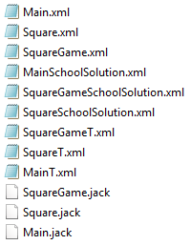
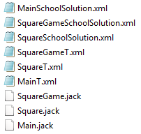
Executing script: Jackanalyzer.bat
The executing script will be named after the specific ex, and will pass the argument to the relevant program.
java example: java JackAnalyzer %1
Notes:
Error: Registry key 'Software\JavaSoft\Java Runtime Environment'\CurrentVersion' has value '1.8', but '1.7' is required.
Read more: https://apkstudio.codeplex.com/workitem/3

Slide 11

Absolute, Relative and Canonical Path
Example: We have two directories, temp and temp1 and test.txt file is in temp directory.
You may have the following possible absolute paths that refer to the same file test.txt.
Absolute path defines path from root of the file system.
Relative path is relative to the directory you are in, so if you are in the above directory, then if you reference file test.txt as relative, it assumes the same directory you are in.
Canonical paths are absolute (but not all absolute paths are canonical).
When you do ‘../’ then it goes back one directory, also known as parent directory.
Notes:
For the above example, we have one and only one canonical path: C:\temp\test.txt

Slide 12
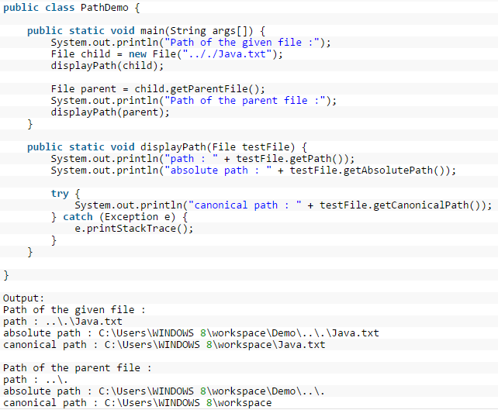

Slide 13
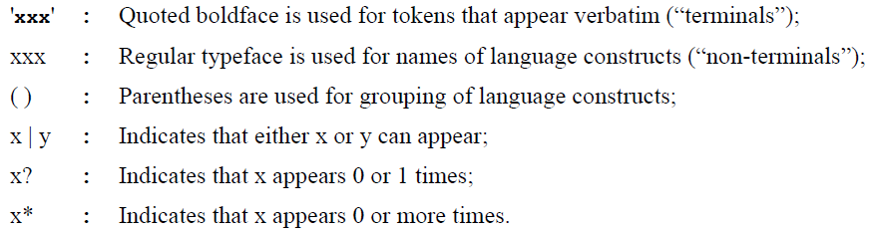
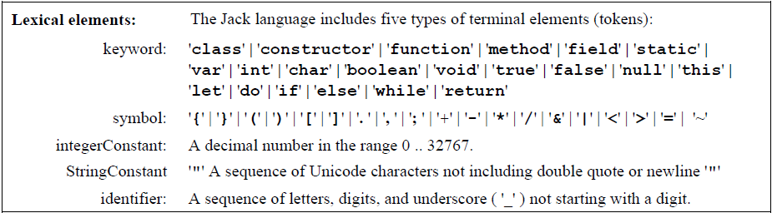
The Jack Language Grammar

Slide 14
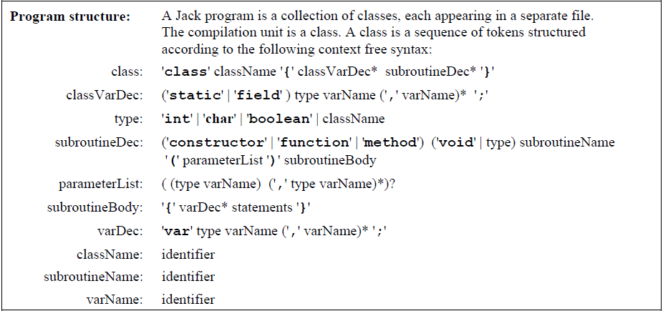

Slide 15
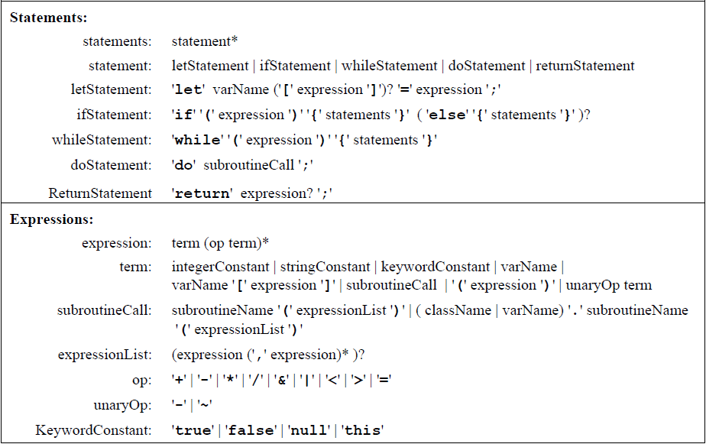

Slide 16
class Main { /** Initializes a new game and starts it. */ function void main() { var SquareGame game; let game = SquareGame.new(); do game.run(); do game.dispose(); return; } } | <tokens> <keyword>class</keyword> <identifier>Main</identifier> <symbol>{</symbol> <keyword>function</keyword> <keyword>void</keyword> <identifier>main</identifier> <symbol>(</symbol> <symbol>)</symbol> <symbol>{</symbol> <keyword>var</keyword> <identifier>SquareGame</identifier> <identifier>game</identifier> <symbol>;</symbol> <keyword>let</keyword> <identifier>game</identifier> <symbol>=</symbol> <identifier>SquareGame</identifier> <symbol>.</symbol> <identifier>new</identifier> <symbol>(</symbol> <symbol>)</symbol> <symbol>;</symbol> <keyword>do</keyword> <identifier>game</identifier> <symbol>.</symbol> <identifier>run</identifier> <symbol>(</symbol> <symbol>)</symbol> <symbol>;</symbol> … | <class> <keyword>class</keyword> <identifier>Main</identifier> <symbol>{</symbol> <subroutineDec> <keyword>function</keyword> <keyword>void</keyword> <subroutineName> <identifier>main</identifier> </subroutineName> <symbol>(</symbol> <parameterList></parameterList> <symbol>)</symbol> <subroutineBody> <symbol>{</symbol> <varDec> <keyword>var</keyword> <type> <identifier>SquareGame</identifier> </type> <identifier>game</identifier> <symbol>;</symbol> </varDec> <statements> <statement> <letStatement> <keyword>let</keyword> <identifier>game</identifier> <symbol>=</symbol> <expression> <term> <subroutineCall> <identifier>SquareGame</identifier> …

Slide 17
Symbols
4 of the symbols used in the Jack language (<, >,", & ) are also used for XML markup - thus they cannot appear as data in XML files. To solve the problem, we require the tokenizer to output these tokens as:
Example: <symbol> < </symbol> → <symbol> &lt; </symbol>
original | Xml notation
< | &lt;
> | &gt;
“ | &quot;
& | &amp;

Slide 18
Twist
We wish to extend the jack language and to add a power operator with ^.
Example: 3^2 = 9
Remember that you don't need to implement the operator or the function, just to identify it in the text and handle it like other operator.

Slide 19
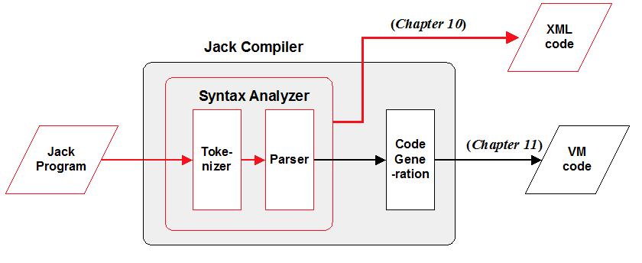
Implementation
We suggest arranging the implementation in three modules:
JackAnalyzer: Top level driver that sets up and invokes the other modules.
JackTokenizer: Tokenizer.
CompilationEngine: Recursive top-down parser.

Slide 20
The JackAnalyzer Module
The analyzer program operates on a given source (Xxx.jack or a directory name). For each source Xxx.jack file, the analyzer goes through the following logic:
Create a JackTokenizer from the Xxx.jack input file;
Create an output file called Xxx.xml and prepare it for writing;
Use the CompilationEngine to compile the input JackTokenizer into the output output file.
(the source file available in the Ex02.zip)

Slide 21
The JackTokenizer Module
Removes all comments and white space from the input stream and breaks it into Jack-language tokens, as specified by the Jack grammar.
(the source file available in the Ex02.zip)

Slide 22
The CompilationEngine Module
Effects the actual compilation output. Gets its input from a JackTokenizer and emits its parsed structure into an output file/stream.
The output is generated by a series of compilexxx() routines, one for every syntactic element xxx of the Jack grammar.
The contract between these routines is that each compilexxx() routine should read the syntactic construct xxx from the input, advance() the tokenizer exactly beyond xxx, and output the parsing of xxx.

Slide 23
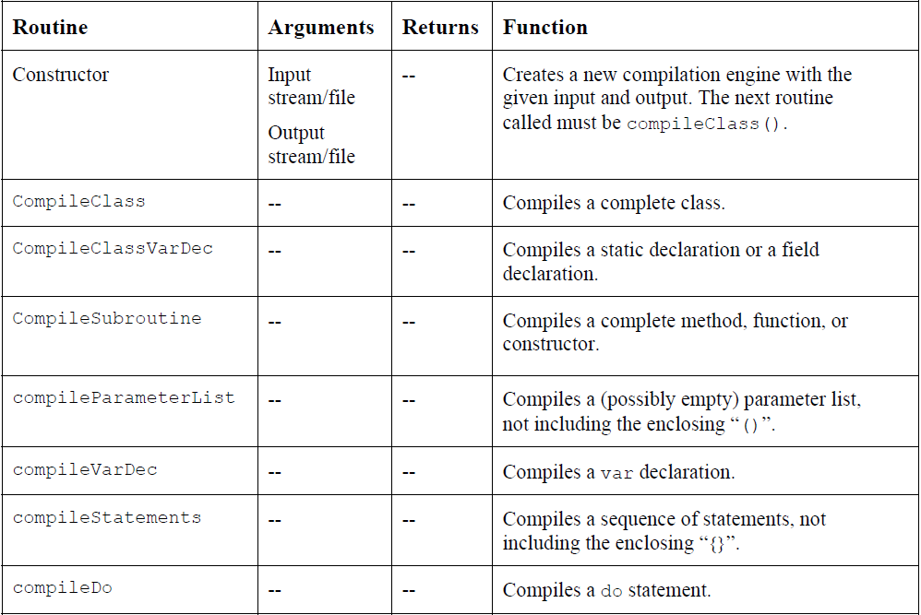

Slide 24
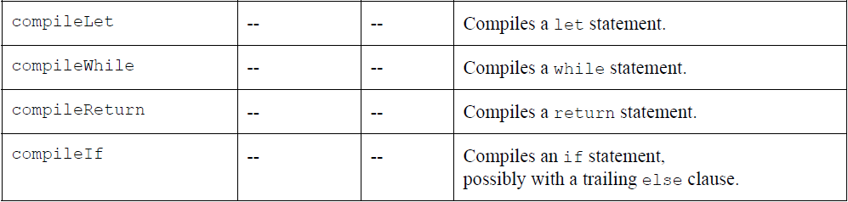
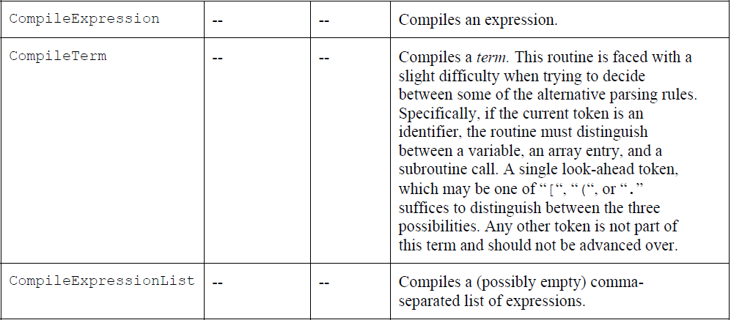

Slide 25
How and what to submit
Create a folder named 2015B_exXX_YYYYYYYY, when XX is the ex number, and YYYYYYYY is your ID.
For example: 2015B_ex02_320457807
All submission files should be in that folder, and no other extra file. Files to submit: source files, README.txt
Zip the folder to a zip file named 2015B_exXX_YYYYYYYY.zip

